Slide 1

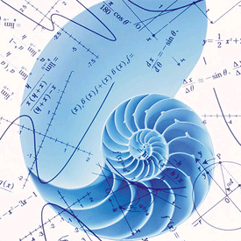
Azərbaycan Dövlət Neft və Sənaye Universiteti
Numerical Methods I

Slide 2
Round-Off Errors:
Arithmetic Manipulations

Slide 3
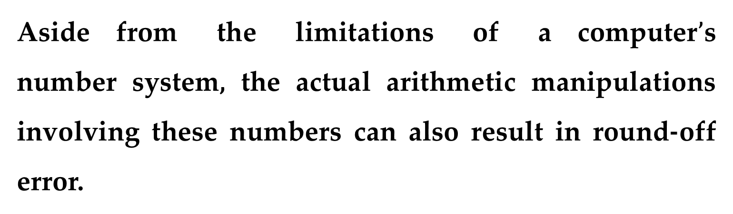
Aside from the limitations of a computer$’$s number system, the actual arithmetic manipulations involving these numbers can also result in round-off error.
In the following section, we will first illustrate how common arithmetic operations affect round-off errors.
Then we will investigate a number of particular manipulations that are especially prone to round-off errors.

Slide 4
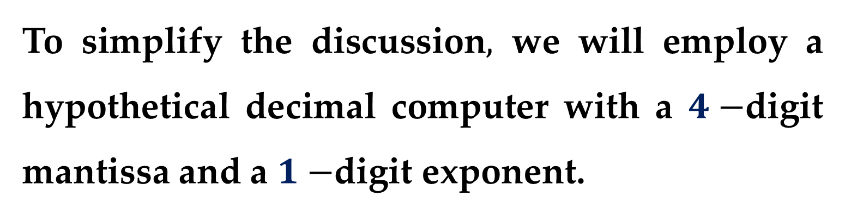
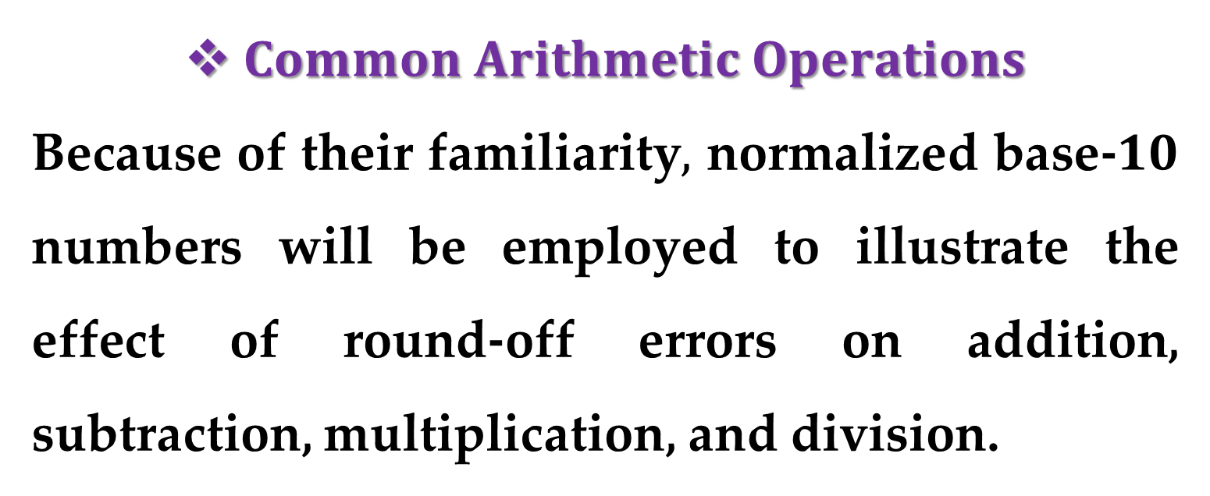
$Common Arithmetic Operations$
Because of their familiarity$,$ normalized base-$10$ numbers will be employed to illustrate the effect of round-off errors on addition, subtraction, multiplication, and division.
To simplify the discussion$,$ we will employ a hypothetical decimal computer with a $4−$digit mantissa and a $1−$digit exponent.

Slide 5

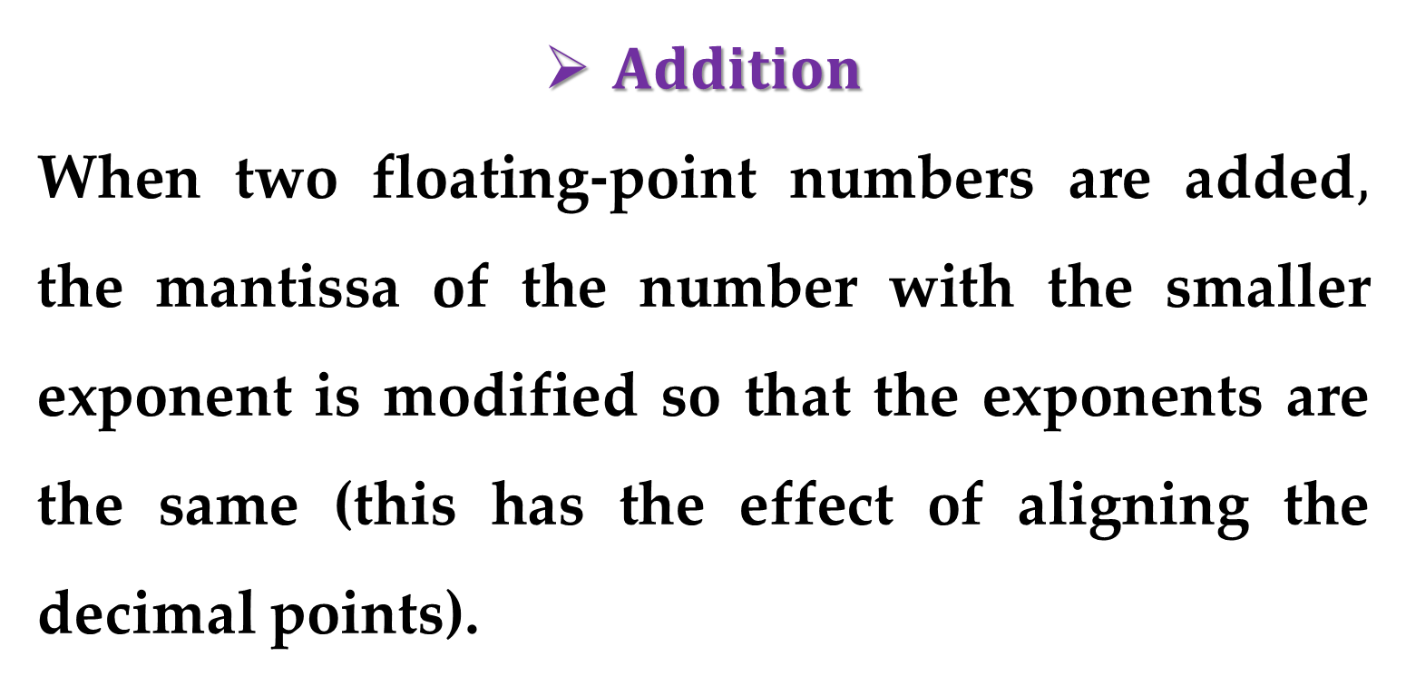
$Addition$
When two floating-point numbers are added$,$ the mantissa of the number with the smaller exponent is modified so that the exponents are the same (this has the effect of aligning the decimal points).
For example$,$ suppose we want to add
$$0.1557∙10^{1}+0.4381∙10^{−1}$$

Slide 6
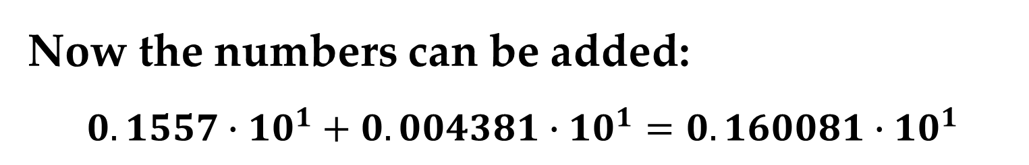
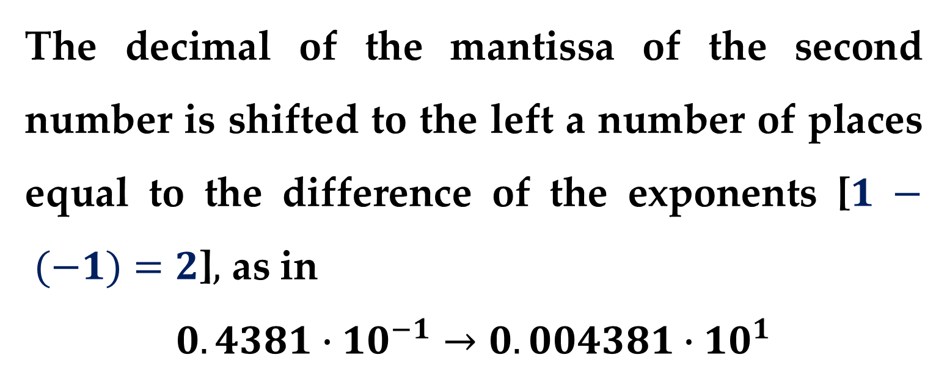
The decimal of the mantissa of the second number is shifted to the left a number of places equal to the difference of the exponents [$1 − (−1)=2$]$,$ as in
$$0.4381∙10^{−1}→0.004381∙10^{1}$$
Now the numbers can be added:
$$0.1557∙10^{1}+0.004381∙10^{1}=0.160081∙10^{1}$$

Slide 7

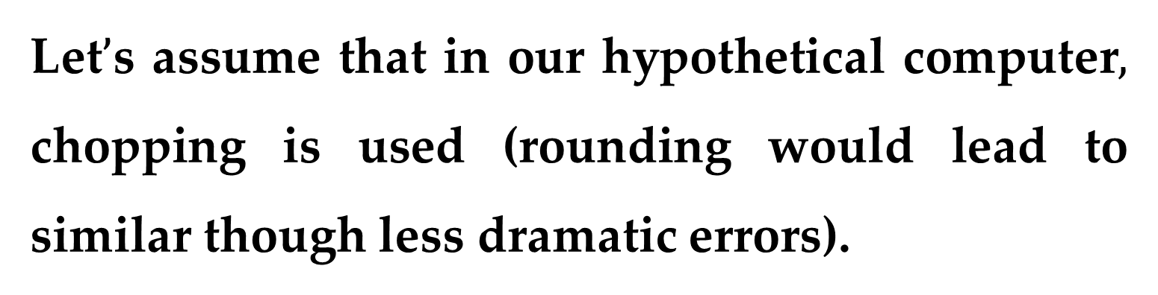
Let$’$s assume that in our hypothetical computer$,$ chopping is used (rounding would lead to similar though less dramatic errors).
The result of addition is chopped to
$$0.1600∙10^{1}$$
Notice how the last two digits of the second number that were shifted to the right have essentially been lost from the computation.

Slide 8
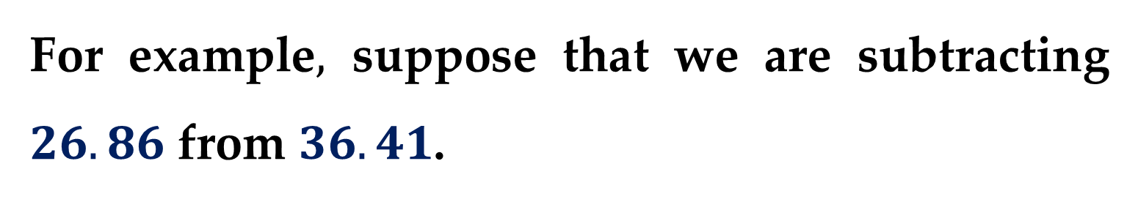
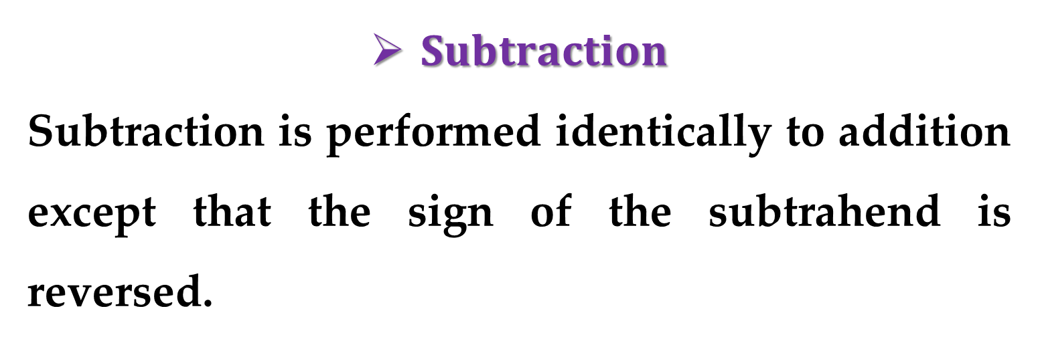
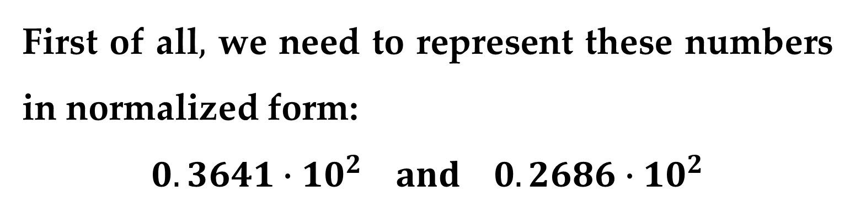
$Subtraction$
Subtraction is performed identically to addition except that the sign of the subtrahend is reversed.
For example$,$ suppose that we are subtracting $26.86$ from $36.41$.
First of all$,$ we need to represent these numbers in normalized form:
$$0.3641∙10^{2} and 0.2686∙10^{2}$$

Slide 9
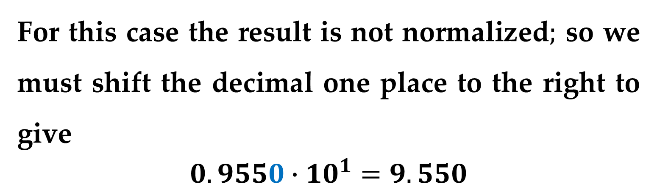
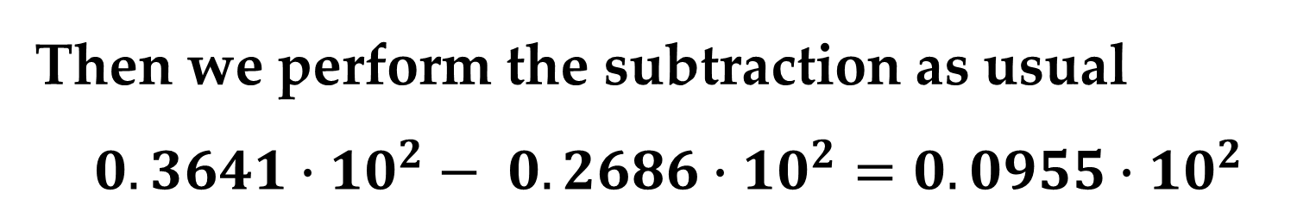
Then we perform the subtraction as usual
$$0.3641∙10^{2}− 0.2686∙10^{2}=0.0955∙10^{2}$$
For this case the result is not normalized$;$ so we must shift the decimal one place to the right to give
$$0.9550∙10^{1}=9.550$$
Notice that zero added to the end of mantissa is not significant but is merely appended to fill the empty space created by the shift.

Slide 10
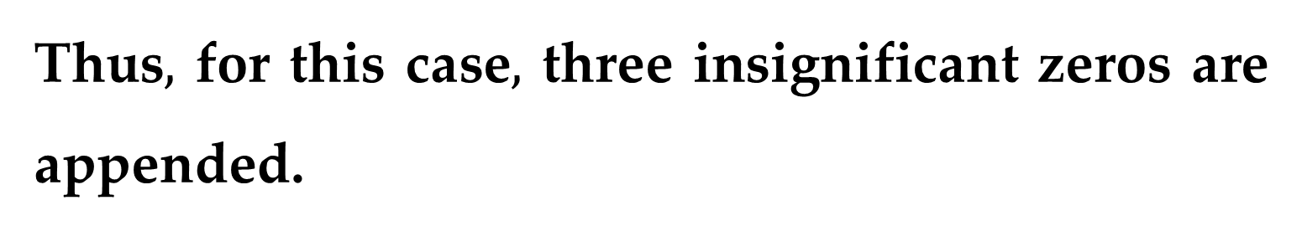
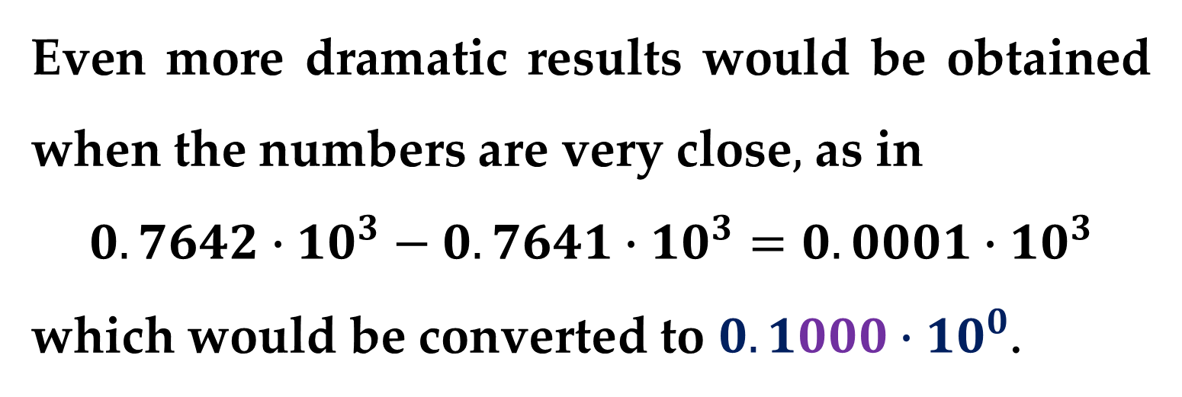
Even more dramatic results would be obtained when the numbers are very close$,$ as in
$$0.7642∙10^{3}−0.7641∙10^{3}=0.0001∙10^{3}$$
which would be converted to $0.1000∙10^{0}$.
Thus$,$ for this case$,$ three insignificant zeros are appended.
This introduces a substantial computational error because subsequent manipulations would act as if these zeros were significant.

Slide 11
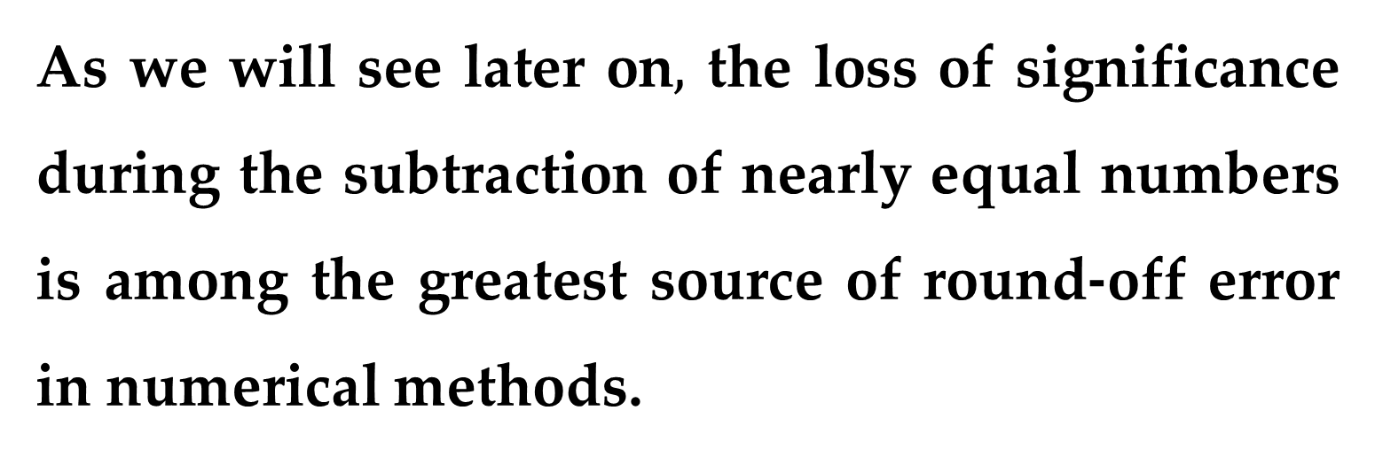
As we will see later on$,$ the loss of significance during the subtraction of nearly equal numbers is among the greatest source of round-off error in numerical methods.

Slide 12
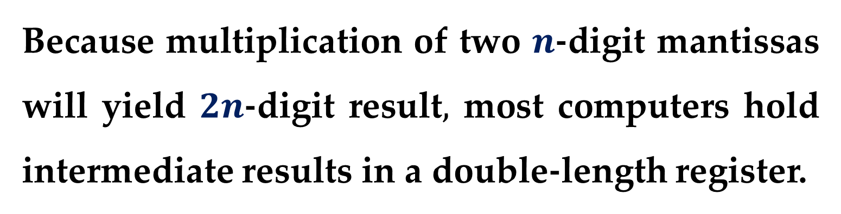
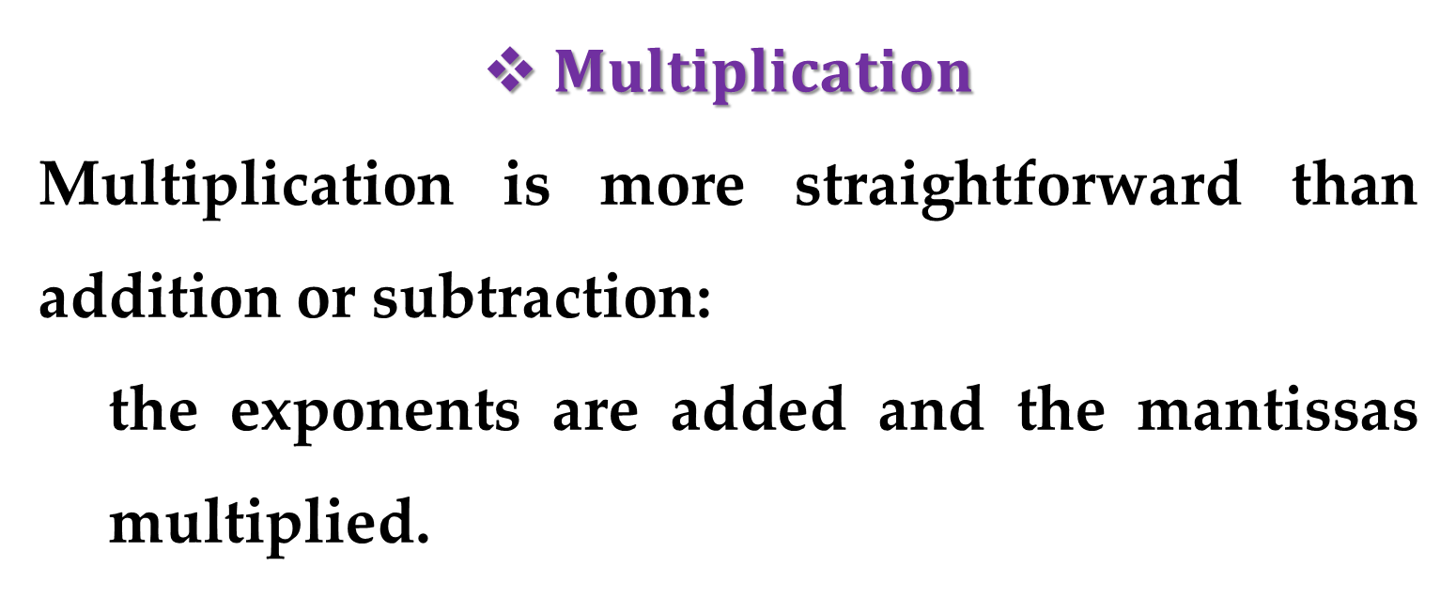
$Multiplication$
Multiplication is more straightforward than addition or subtraction:
the exponents are added and the mantissas multiplied.
Because multiplication of two $n$-digit mantissas will yield $2n$-digit result$,$ most computers hold intermediate results in a double-length register.

Slide 13
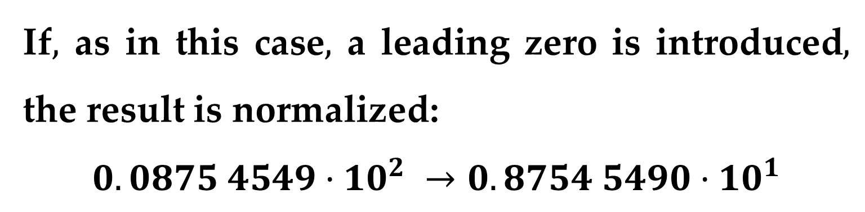
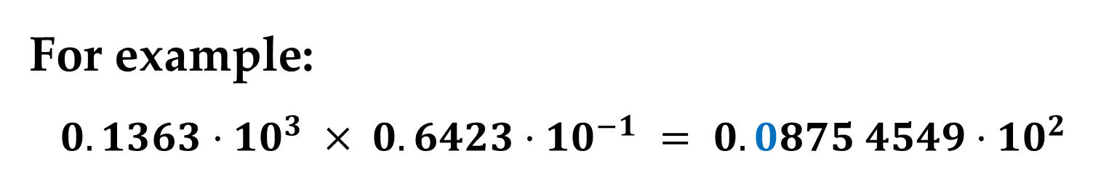
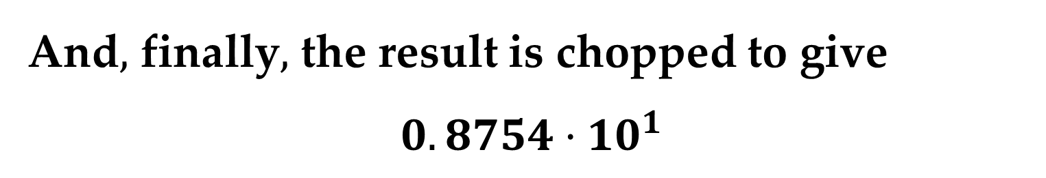
For example:
$$0.1363·10^{3} × 0.6423·10^{−1} = 0.0875 4549·10^{2}$$
If$,$ as in this case$,$ a leading zero is introduced$,$ the result is normalized:
$$0.0875 4549·10^{2} →0.8754 5490·10^{1}$$
And$,$ finally$,$ the result is chopped to give
$$0.8754·10^{1}$$

Slide 14
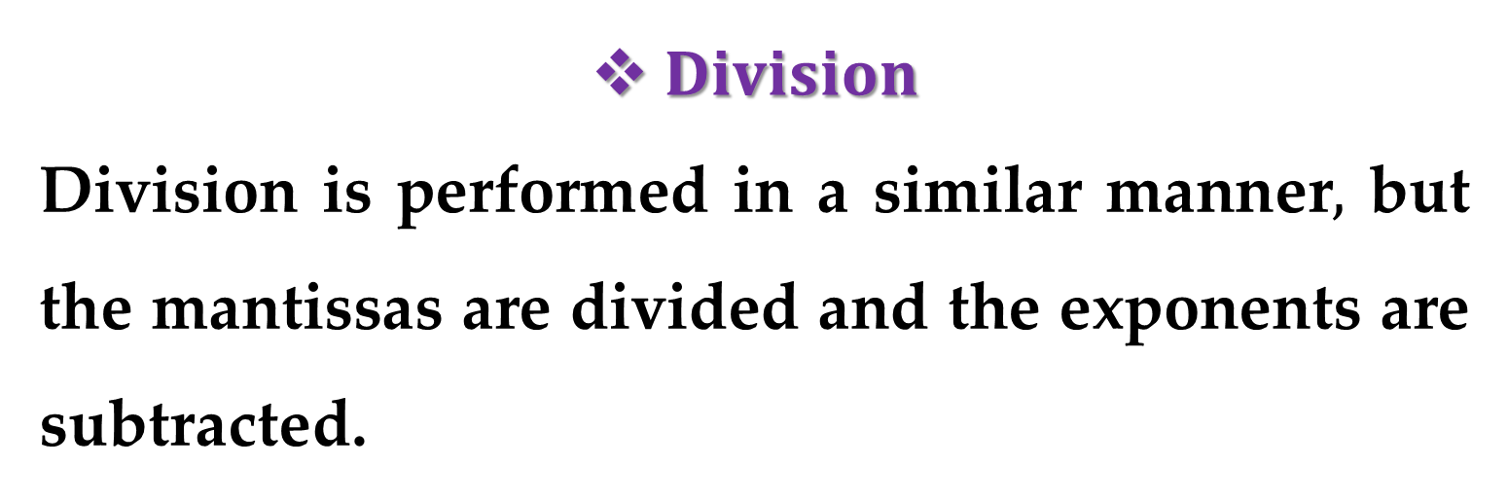
$Division$
Division is performed in a similar manner$,$ but the mantissas are divided and the exponents are subtracted.
Then the results are normalized and chopped.

Slide 15
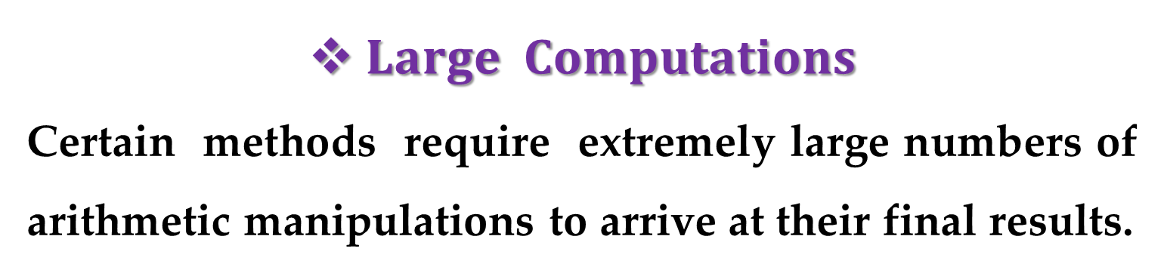
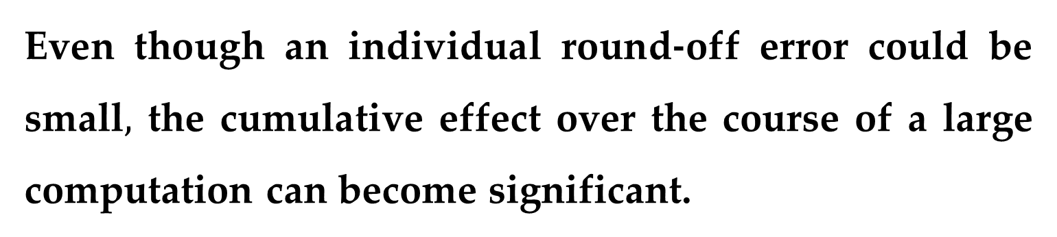
$Large Computations$
Certain methods require extremely large numbers of arithmetic manipulations to arrive at their final results.
In addition, these computations are often interdependent – that is, later calculations are dependent on the results of earlier ones.
Even though an individual round-off error could be small$,$ the cumulative effect over the course of a large computation can become significant.

Slide 16
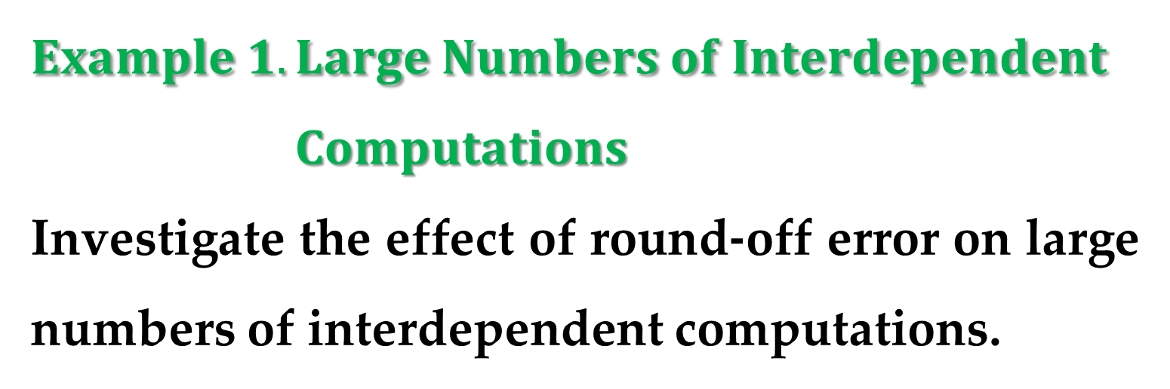
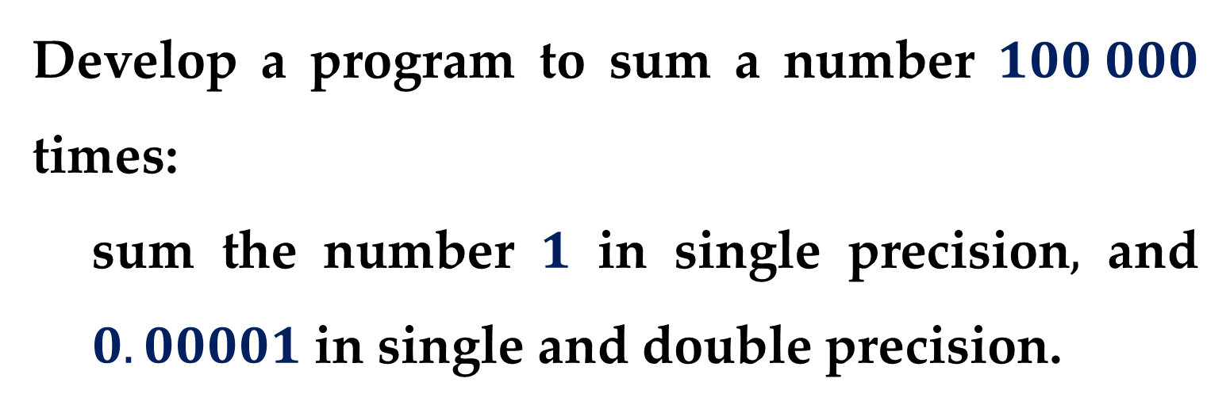
$$Example 1. Large Numbers of Interdependent$$
$Computations$
Investigate the effect of round-off error on large numbers of interdependent computations.
Develop a program to sum a number $100 000$ times:
sum the number $1$ in single precision$,$ and $0.00001$ in single and double precision.

Slide 17
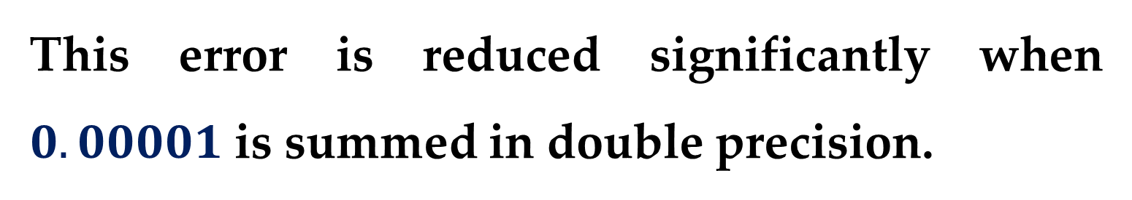
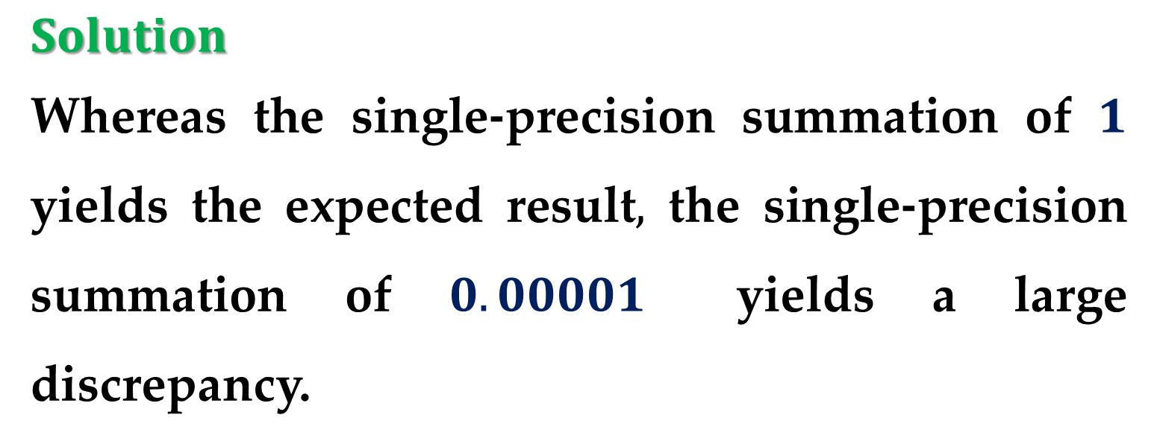
$$Solution$$
Whereas the single-precision summation of $1$ yields the expected result$,$ the single-precision summation of $0.00001$ yields a large discrepancy.
This error is reduced significantly when $0.00001$ is summed in double precision.
Quantizing errors are the source of the discrepancies.

Slide 18
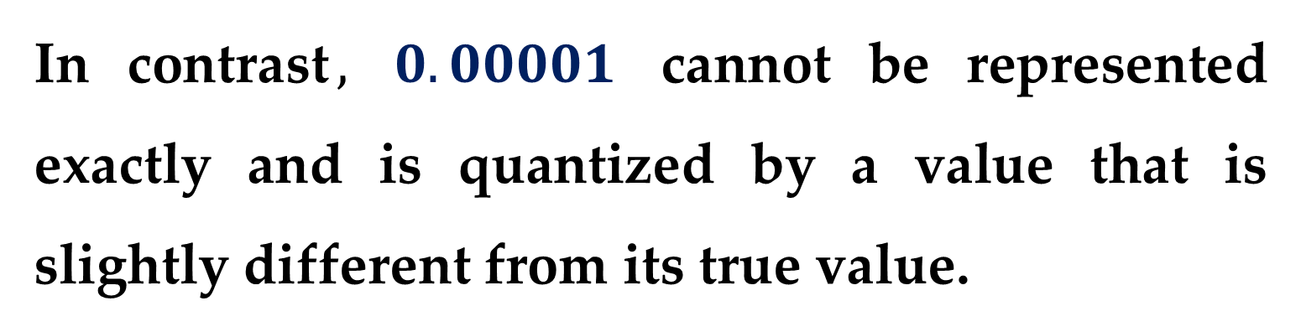
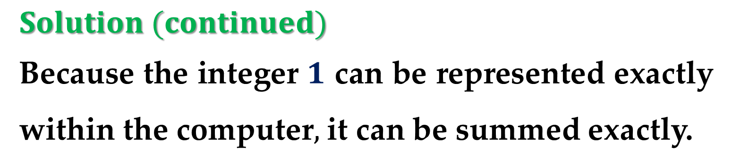
$$Solution (continued)$$
Because the integer $1$ can be represented exactly within the computer$,$ it can be summed exactly.
In contrast$,$ $0.00001$ cannot be represented exactly and is quantized by a value that is slightly different from its true value.
Whereas this very slight discrepancy would be negligible for a small number of computations, it accumulates after repeated summations.

Slide 19
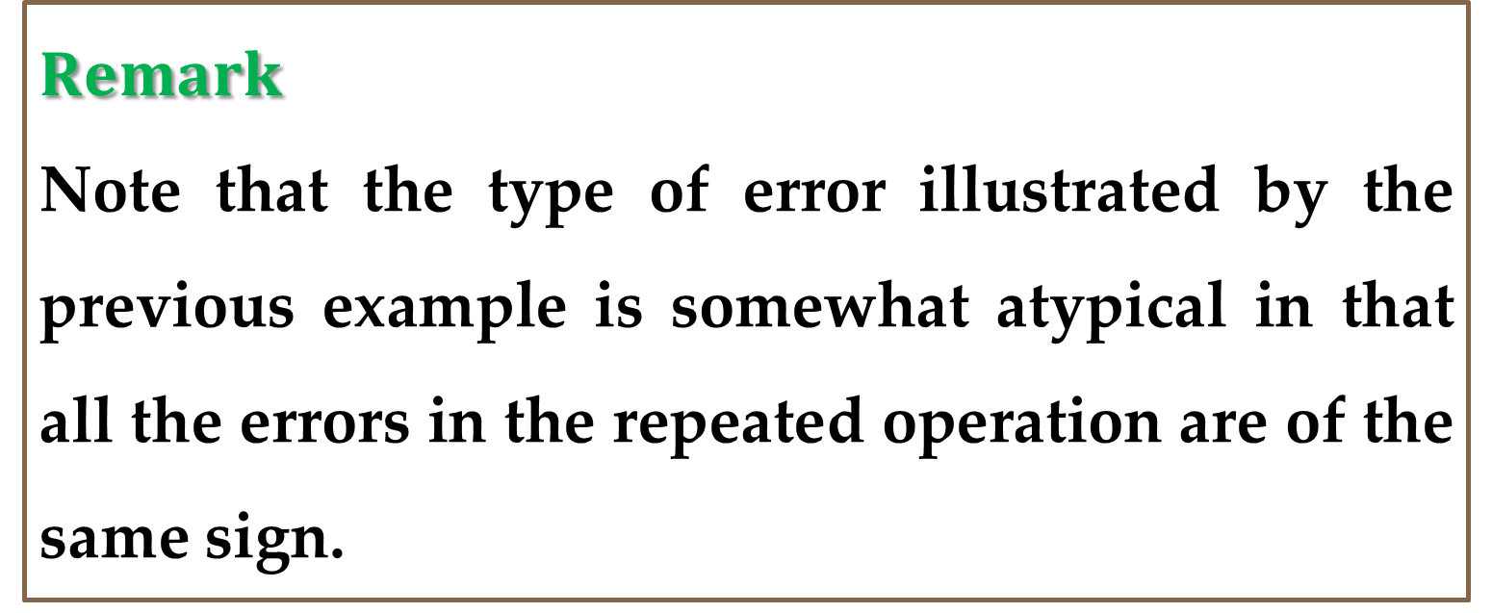
The problem still occurs in double precision but is greatly mitigated because the quantizing error is much smaller.
$$Remark$$
Note that the type of error illustrated by the previous example is somewhat atypical in that all the errors in the repeated operation are of the same sign.

Slide 20
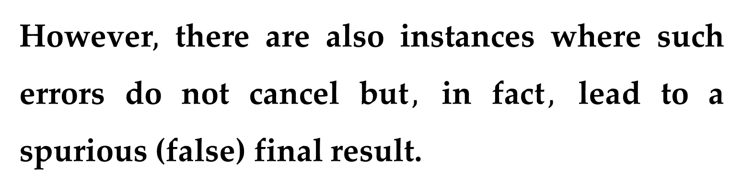
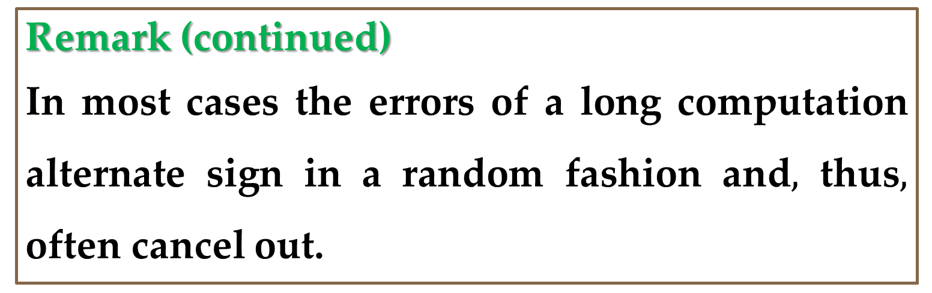
Remark (continued)
In most cases the errors of a long computation alternate sign in a random fashion and$,$ thus$,$ often cancel out.
However$,$ there are also instances where such errors do not cancel but$,$ in fact$,$ lead to a spurious (false) final result.
The following sections are intended to provide insight into ways in which this may occur.

Slide 21
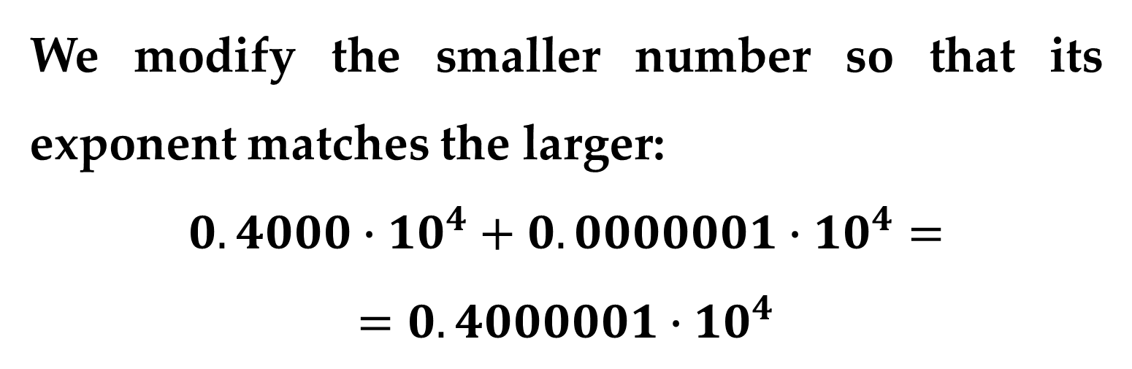
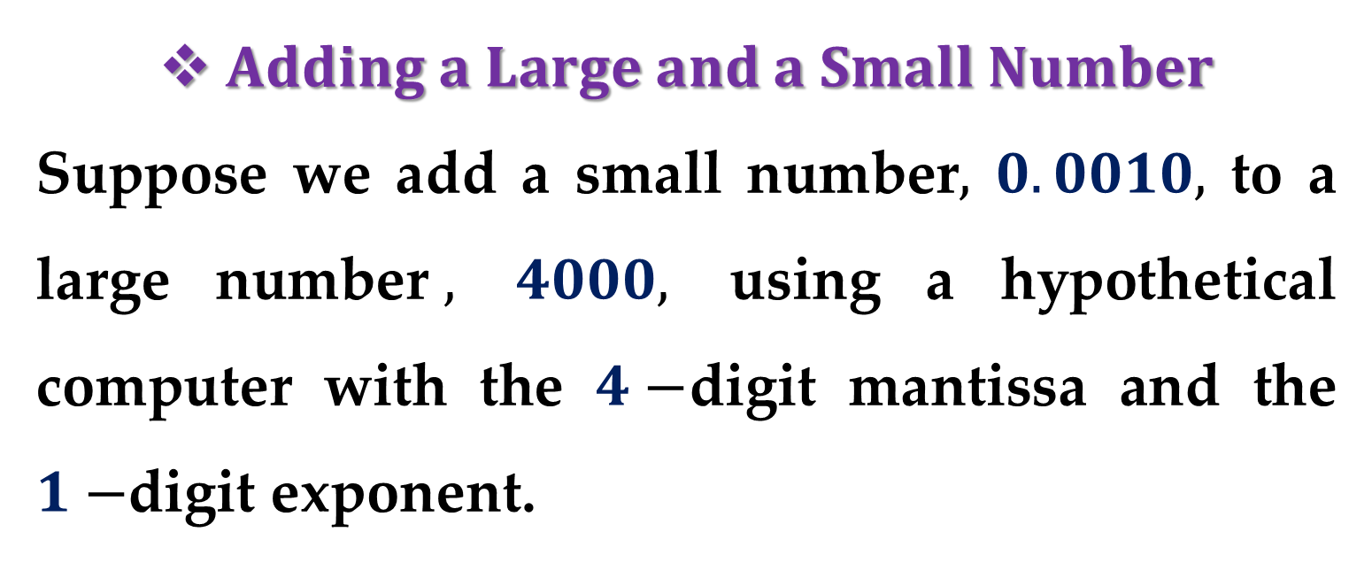
$Adding a Large and a Small Number$
Suppose we add a small number$,$ $0.0010,$ to a large number$,$ $4000,$ using a hypothetical computer with the $4−$digit mantissa and the $1−$digit exponent.
We modify the smaller number so that its exponent matches the larger:
$$0.4000∙10^{4}+0.0000001∙10^{4}=$$
$$=0.4000001∙10^{4}$$

Slide 22
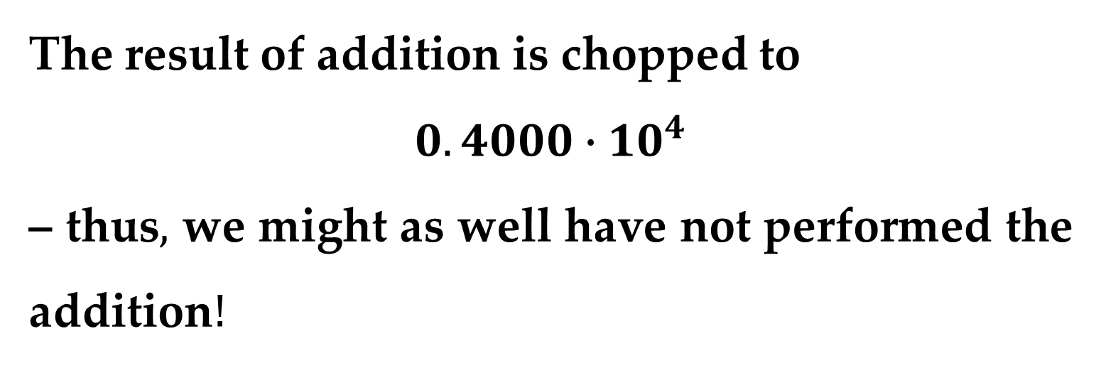
The result of addition is chopped to
$$0.4000∙10^{4}$$
– thus$,$ we might as well have not performed the addition$!$
This type of error can occur in the computation of an infinite series.
The initial terms in such series are often relatively large in comparison with the later terms.

Slide 23
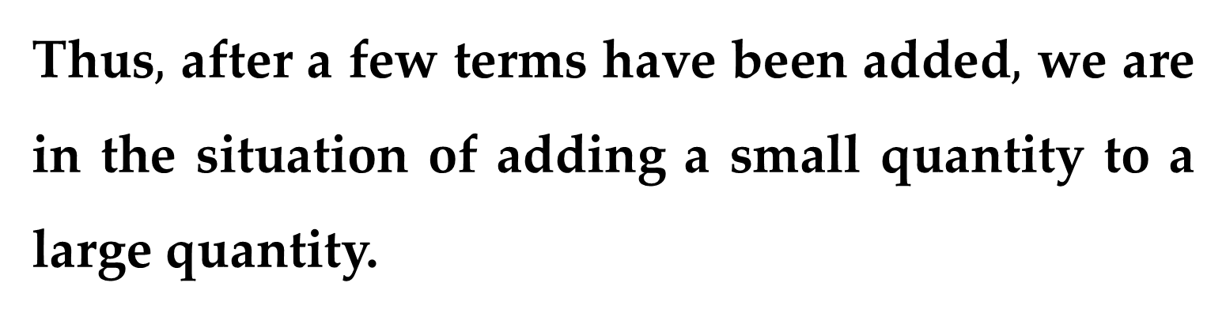
Thus$,$ after a few terms have been added$,$ we are in the situation of adding a small quantity to a large quantity.
One way to mitigate this type of error is to sum the series in reverse order — i.e. in ascending rather than descending order.
In this way, each new term will be of comparable magnitude to the accumulated sum.

Slide 24
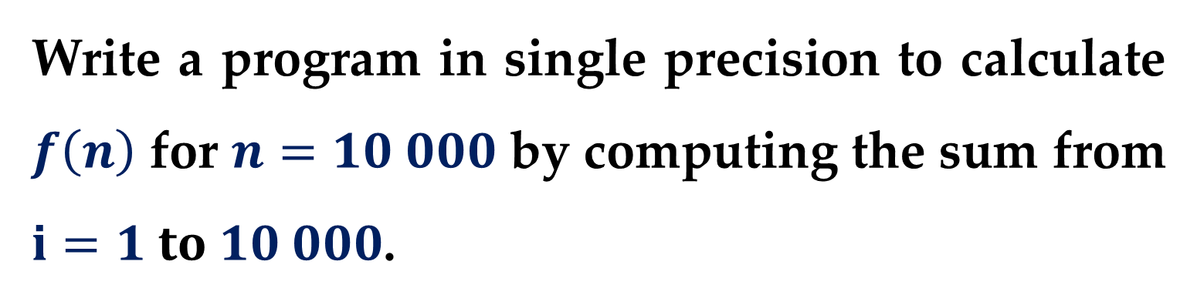
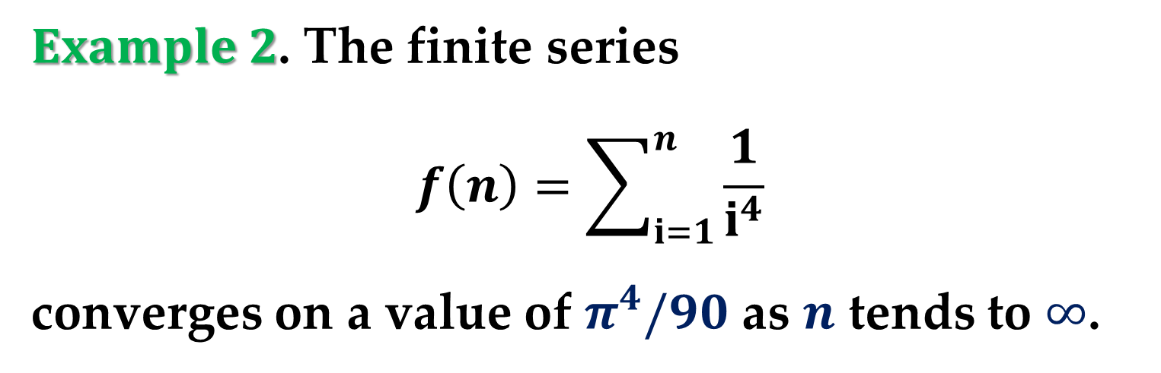
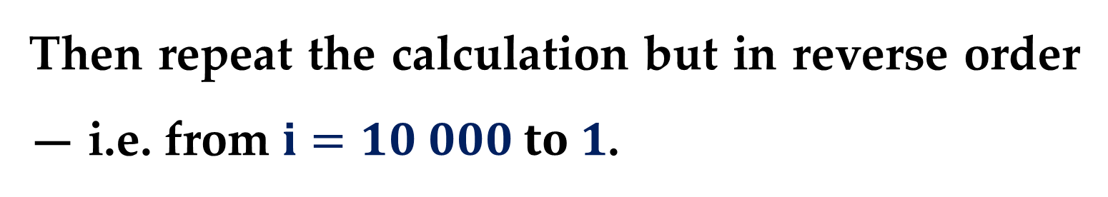
$Example 2$. The finite series
$$f\left(n\right)=\sum_{i=1}^{n}{\frac{1}{i^{4}}}$$
converges on a value of $π^{4}/90$ as $n$ tends to $∞$.
Write a program in single precision to calculate $f\left(n\right)$ for $n=10 000$ by computing the sum from $i=1 to 10 000$.
Then repeat the calculation but in reverse order — i.e. from $i=10 000 to 1$.

Slide 25
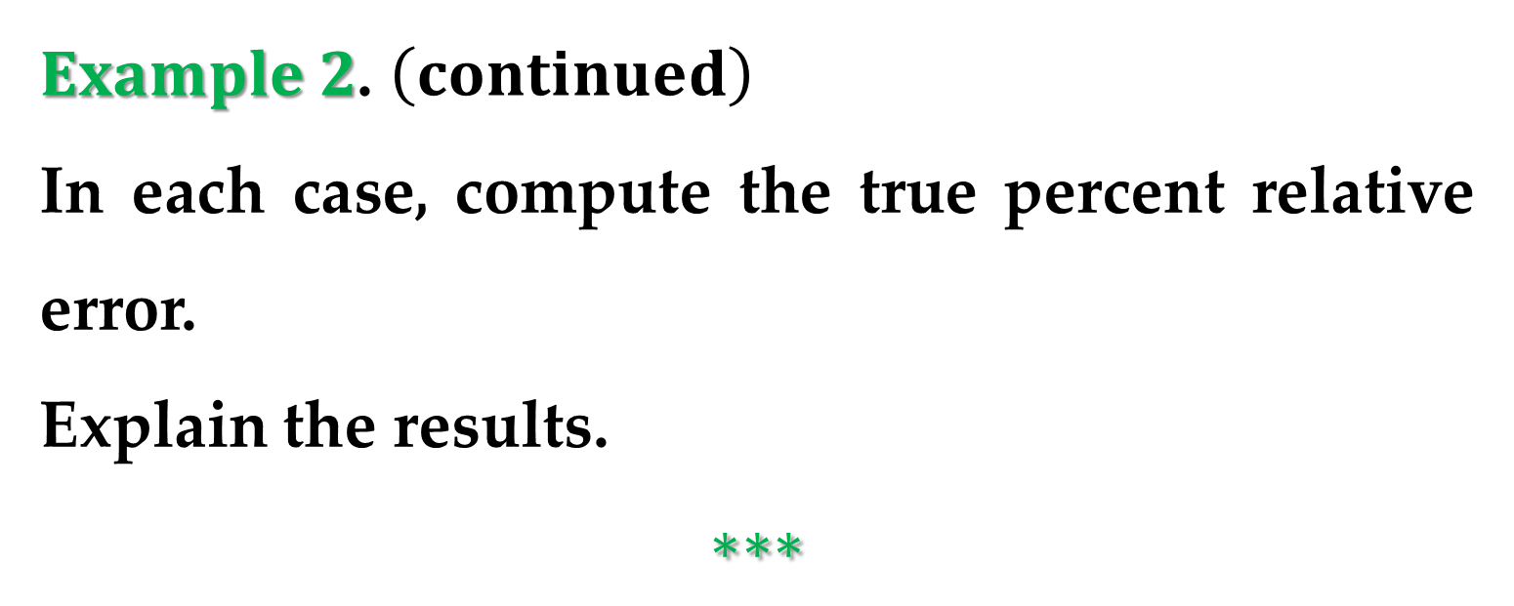
$Example 2$. $\left(continued\right)$
In each case, compute the true percent relative error.
Explain the results.
$$∗∗∗$$

Slide 26
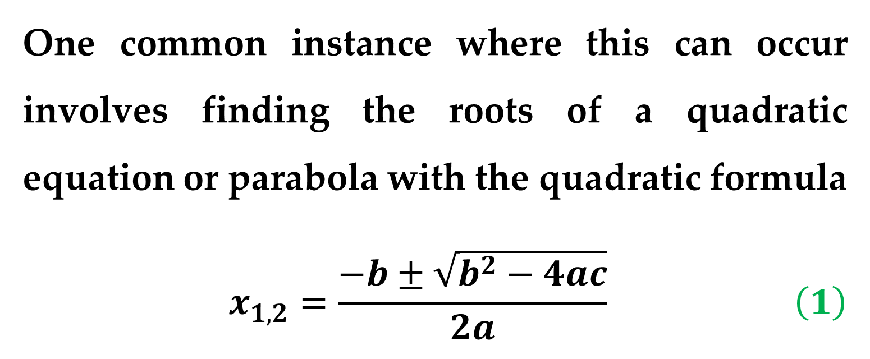
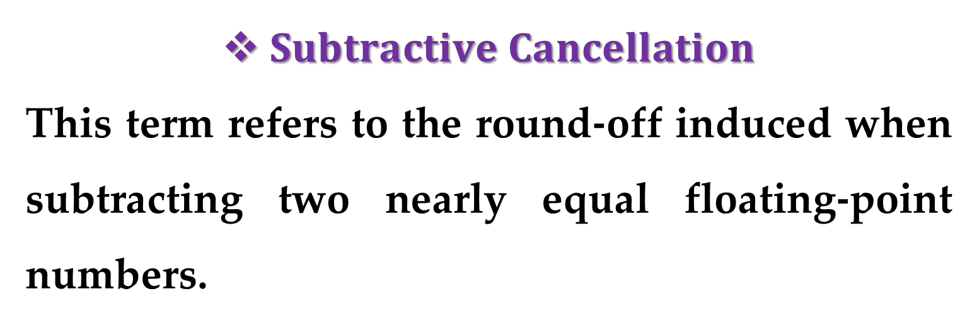
$Subtractive Cancellation$
This term refers to the round-off induced when subtracting two nearly equal floating-point numbers.
One common instance where this can occur involves finding the roots of a quadratic equation or parabola with the quadratic formula
$$x_{1,2}=\frac{−b±\sqrt{b^{2}−4ac}}{2a} \left(1\right)$$

Slide 27
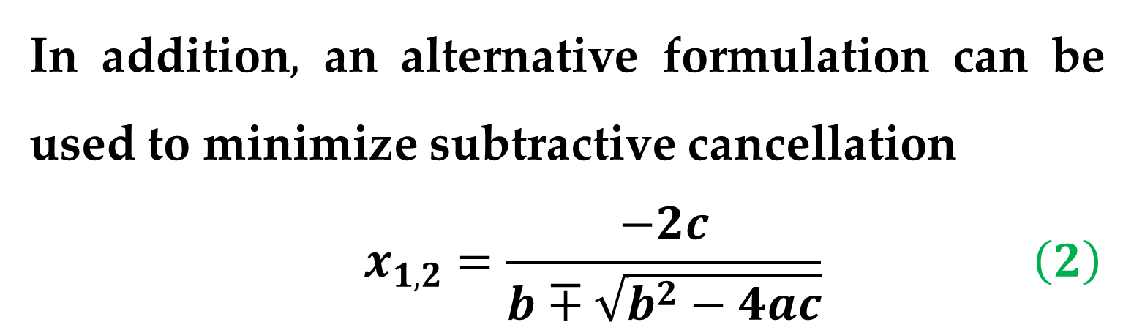
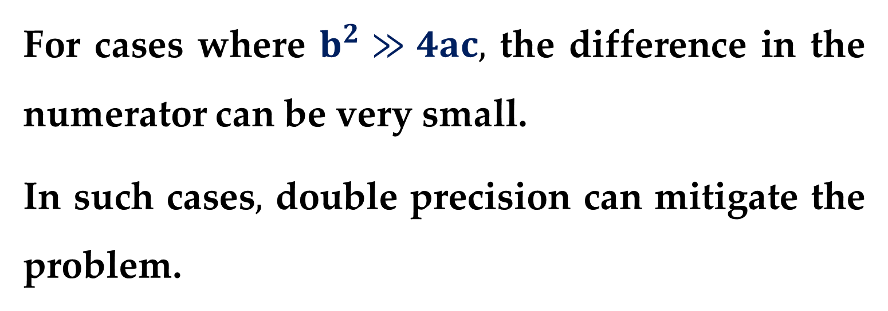
For cases where $b^{2}≫4ac,$ the difference in the numerator can be very small.
In such cases$,$ double precision can mitigate the problem.
In addition$,$ an alternative formulation can be used to minimize subtractive cancellation
$$x_{1,2}=\frac{−2c}{b∓\sqrt{b^{2}−4ac}} \left(2\right)$$

Slide 28
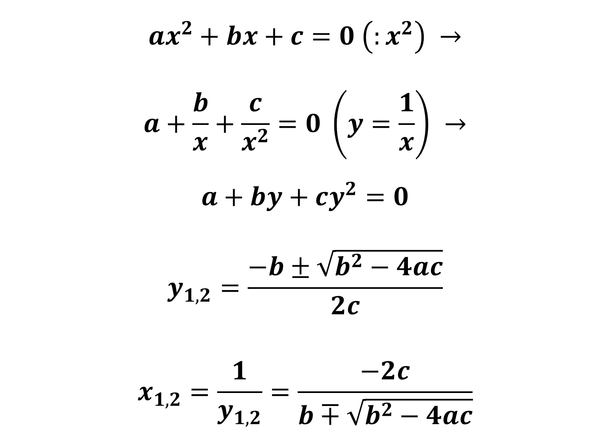
$$ax^{2}+bx+c=0 \left(:x^{2}\right) →$$
$$a+\frac{b}{x}+\frac{c}{x^{2}}=0 \left(y=\frac{1}{x}\right) →$$
$$a+by+cy^{2}=0$$
$$y_{1,2}=\frac{−b±\sqrt{b^{2}−4ac}}{2c}$$
$$x_{1,2}=\frac{1}{y_{1,2}}=\frac{−2c}{b∓\sqrt{b^{2}−4ac}}$$

Slide 29
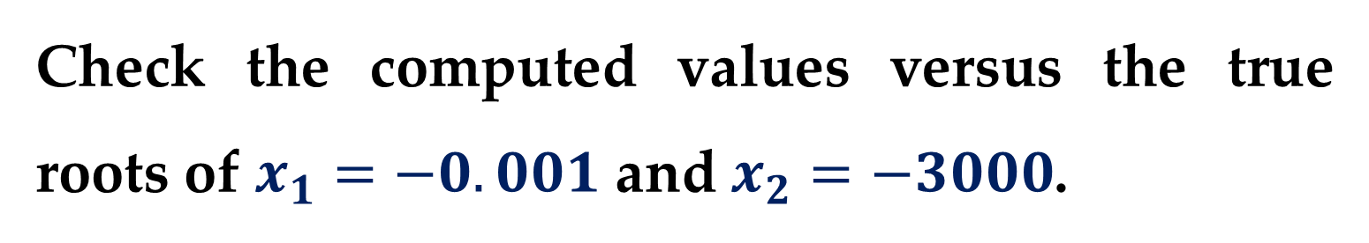
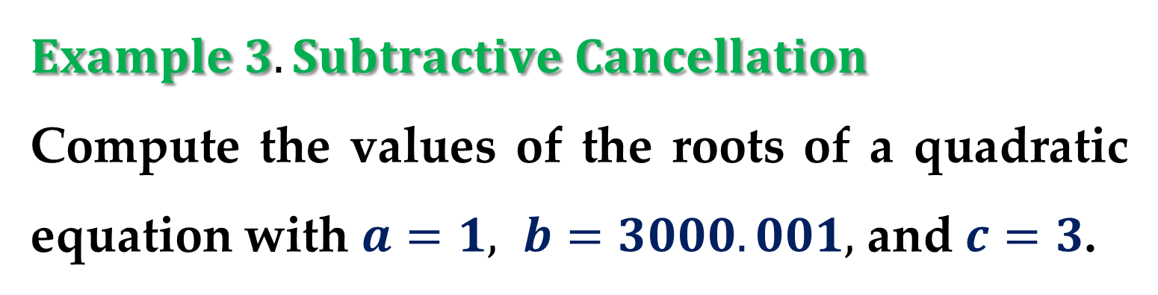
An illustration of the problem and the use of this alternative formula are provided in the following example.
$$Example 3. Subtractive Cancellation$$
Compute the values of the roots of a quadratic equation with $a=1, b=3000.001,$ and $c=3$.
Check the computed values versus the true roots of $x_{1}=−0.001$ and $x_{2}=−3000$.

Slide 30
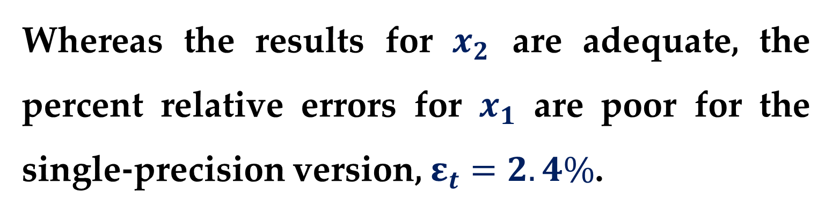
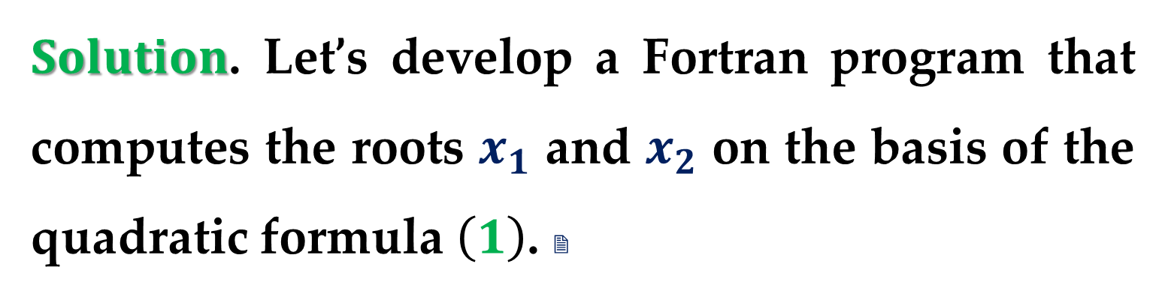
$Solution$. Let’s develop a Fortran program that computes the roots $x_{1}$ and $x_{2}$ on the basis of the quadratic formula $\left(1\right)$. 
Whereas the results for $x_{2}$ are adequate, the percent relative errors for $x_{1}$ are poor for the single-precision version, $ε_{t}=2.4\%$.
This level could be inadequate for many applied scientific and engineering problems.

Slide 31


$Solution$. $\left(continued\right)$ This result is particularly surprising because we are employing an analytical formula to obtain our solution.
The loss of significance occurs in the line of both equations, $\left(1\right)$ and $\left(2\right),$ where two relatively large numbers are subtracted.
Similar problems do not occur when the same numbers are added.

Slide 32


On the basis of the above$,$ we can draw the general conclusion that the quadratic formula will be susceptible to subtractive cancellation whenever $b^{2}≫4ac$.
One way to circumvent this problem is to use double precision. 
Another is to recast the quadratic formula in the format of Eq. $(2)$.

Slide 33


As in the program output, both options give a much smaller error because the subtractive cancellation is minimized or avoided.
Note that$,$ as in the foregoing example$,$ there are times where subtractive cancellation can be circumvented by using a transformation.
However$,$ the only general remedy is to employ extended precision.

Slide 34


$Smearing$
Smearing occurs whenever the individual terms in a summation are larger than the summation itself.
$Example 4. Evaluation of e^{x}$ $using Infinite$
$Series$
This example demonstrates one case where smearing occurs – in series of mixed signs.

Slide 35


$$Example 4. (continued)$$
The exponential function $y=e^{x}$ is given by the infinite series
$$e^{x}=1+x+\frac{x^{2}}{2!}+\frac{x^{3}}{3!}+…$$
Evaluate this function for $x=10$ and $x=−10,$ and be attentive to the problems of round-off error.

Slide 36



$Solution$. Let’s develop an Excel/VBA program that uses the infinite series to evaluate $e^{x}$. 
The variable $i$ is the number of terms in the series;
$term$ is the value of the current term added to the series;
$sum$ is the accumulative value of the series.
The variable $test$ is the preceding accumulative value of the series prior to adding $term$.

Slide 37



$Solution$. $\left(continued\right)$
The series is terminated when the computer cannot detect the difference between $test$ and $sum$.
$Figure 1a$ shows the results of running the program for $x=10$.

Slide 38


$Solution$. $\left(continued\right)$
Note that this case is completely satisfactory.
The final result is achieved in $31$ terms with the series identical to the library function value within seven significant figures.

Slide 39


$Solution$. $\left(continued\right)$
$Figure 1b$ shows similar results for $x=−10$.
However, for this case, the results of the series calculation are not even the same sign as the true result.

Slide 40

$Solution$. $\left(continued\right)$
As a matter of fact$,$ the negative results are open to serious question because $e^{x}$ can never be less than zero.
The problem here is caused by round-off error (note that many of the terms that make up the sum are much larger than the final result of the sum.)
Furthermore, unlike the previous case, the individual terms vary in sign.

Slide 41


Thus$,$ in effect we are adding and subtracting large numbers (each with some small error) and placing great significance on the differences — that is$,$ subtractive cancellation.
Thus$,$ we can see that the culprit behind this example of smearing is$,$ in fact$,$ subtractive cancellation.
For such cases it is appropriate to seek some other computational strategy.

Slide 42

For example$,$ one might try to compute $y=e^{−10}$ as $y={\left(e^{−1}\right)}^{10}$. 
Other than such a reformulation, the only general recourse is extended precision. 

Slide 43



$Inner Products$
Some infinite series are particularly prone to round-off error.
Fortunately$,$ the calculation of series is not one of the more common operations in numerical methods.
A far more ubiquitous manipulation is the calculation of inner products$,$ as in:
$$\sum_{i=1}^{n}{x_{i} y_{i}}=x_{1}y_{1}+x_{2}y_{2}+…+x_{n}y_{n}$$

Slide 44


This operation is very common$,$ particularly in the solution of simultaneous linear algebraic equations.
Such summations are prone to round-off error.
Consequently$,$ it is often desirable to compute such summations in extended precision.

Slide 45

$$Remark$$
Although the foregoing sections should provide rules of thumb to mitigate round-off error$,$ they do not provide a direct means beyond trial and error to actually determine the effect of such errors on a computation.

Slide 46
Thank you for attention!

